Slide 1
MVCSC
High Ability Program Update, 2021-22

Slide 2
Mission Statement
Mt. Vernon Community School Corporation will provide support and guidance to all identified high ability students, as well as appropriate educational experiences according to their academic ability. We recognize that high ability students are found in all racial, cultural, ethnic, and socio-economic populations. We are committed to an educational program that provides a challenging, differentiated curriculum through a wide range of services to all of our high ability students.

Slide 3
Where we have been...
Where we are now...
2015:
Simiplified identification system
Programming: Elementary- differentiation in a heterogenous classroom, Middle School/HS- Advanced courses
Outsourced grant management
One high ability license for the district
2021:
Systematic three tiered identification plan
Programming: high ability cluster classrooms K-8, Middle School/HS- Advanced courses
Licensed High ability Coordinator and teacher
11 high ability licenced teachers (spring 2022)

Slide 4
Program Evaluation
To continually revise and improve our high ability program through a systematic evaluation process.
To encourage broad-based community participation and support in the planning, implementation, and evaluation of our program.
(See program evaluation rubric and BBPC Agenda handout)

Slide 5
Program Goals
Identification - Curriculum and Instruction- Guidance and Counseling - Professional Development - Program Evaluation

Slide 6
Identification
MV Program Goal: To systematically identify students who demonstrate outstanding achievement or the potential ability to achieve in academic areas, including math and English/language arts.
A High Ability Learner is defined as:
According to Indiana Code, a high ability student is one who: “performs at, or shows the potential for performing at, an outstanding level of accomplishment in at least one domain when compared to other students of the same age, experience, or environment; and is characterized by exceptional gifts, talents, motivation, or interests.” (IC 20-36-1-3)

Slide 7
Measuring Academic Achievement | Measuring Cognitive Potential (Screener) | Measuring Cognitive Potential | Potential Third Qualifying Test
Normative data from the NWEA test is used to identify high academic achievement for students in reading or math. The NWEA is an adaptive test that provides progress scores as well as national/local norms. All students in grades K – 8 participate in the NWEA three times a year. Students in grades 2-5 who score between the 96th - 99th percentile on 2 out of 3 local norms from the administration of NWEA will be identified as automatic qualifiers for service in the areas of mathematics, reading, or both depending on the results of the test. This same automatic qualification applies for students K & 1 using the 98th percentile cut score (due to the nature of a read-aloud version of NWEA). | Students in grades K-8 have scored between the 85th - 96th percentile on the Winter administration of the NWEA will be given the opportunity to participate in the CogAT screener. Those scoring above the 85th percentile on the screener will take the full CogAT. | This round of testing is intended to find any students with cognitive potential that might have been missed through achievement testing. A full version is used to determine eligibility. In measuring cognitive potential, we use the CogAT, a nationally/locally normed test of aptitude. Students in grades K, 2, 5 and 8 will be given the test. If scores are between the 96th - 99th percentile on the full CogAT for grades K, 2, 5 and 8, then this indicates that the student qualifies to receive high ability services. | SIGS, (Scales for Identifying Gifted Students), may be used to elevate a score falling below the cut off in the standard error of measure. This additional source provides information from parents and teachers on a child’s potential giftedness through the following seven scales: * General Intellectual Ability * Language Arts * Mathematics * Science * Social Studies * Creativity * Leadership

Slide 8
2019-2020 DOE Identification Data
2021-22
Identification Smart Goal: to increase representation from diverse racial and ethnic groups, as well as english language learners.
How?
Increase training for teachers on formative assessment based on high ability characteristics
Train guidance counselors on resources and opportunities to support identification and placement for potentially gifted students
Develop additional elements of identification plan that lessen bias and allow room for portfolio and observation
Widen the areas of identification (additional content areas, creativity, leadership)

Slide 9
Curriculum and Instruction
MVCSC Program Goal:
To develop the students' academic skills, higher level thinking skills of analysis, synthesis and evaluation through an accelerated and enriched program. This is accomplished by:
* emphasizing higher level thinking skills and problem-solving
* open-ended questions and activities
* collaboration, group interaction
* multi-disciplinary and multi-sensory approach
* student choices
* study skills - organization, research and questioning strategies

Slide 10
2021-2022
Curriculum and Instruction Smart Goal: Support tier one instruction and increase systems of differentiation
How?
Provide coaching, via the high ability coordinator, on planning and implementing instructional strategies designed for enrichment
Increase classroom teacher access to curriculum designed specifically to support critical thinking and problem solving
Support the PLC process with effective questioning strategies and suggestions on how to answer question #4, they have it now what?

Slide 11
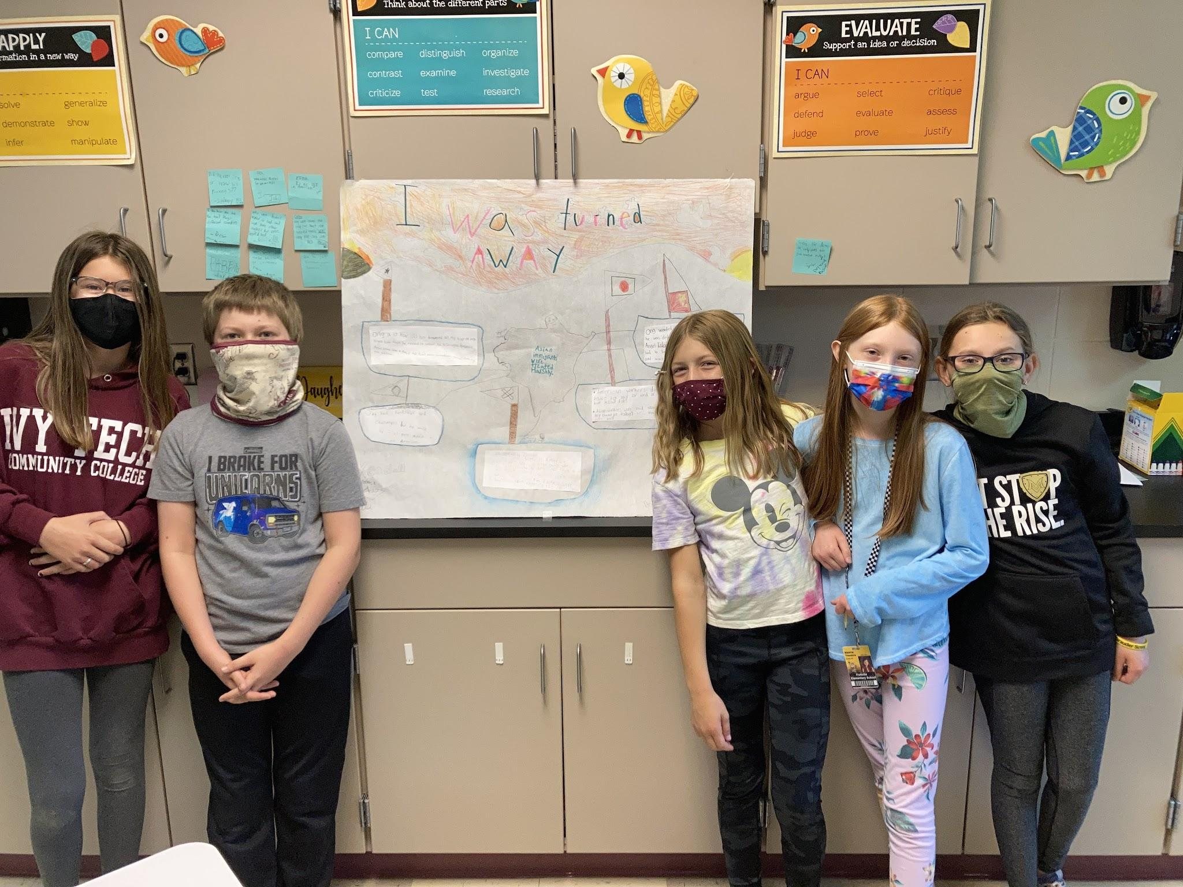
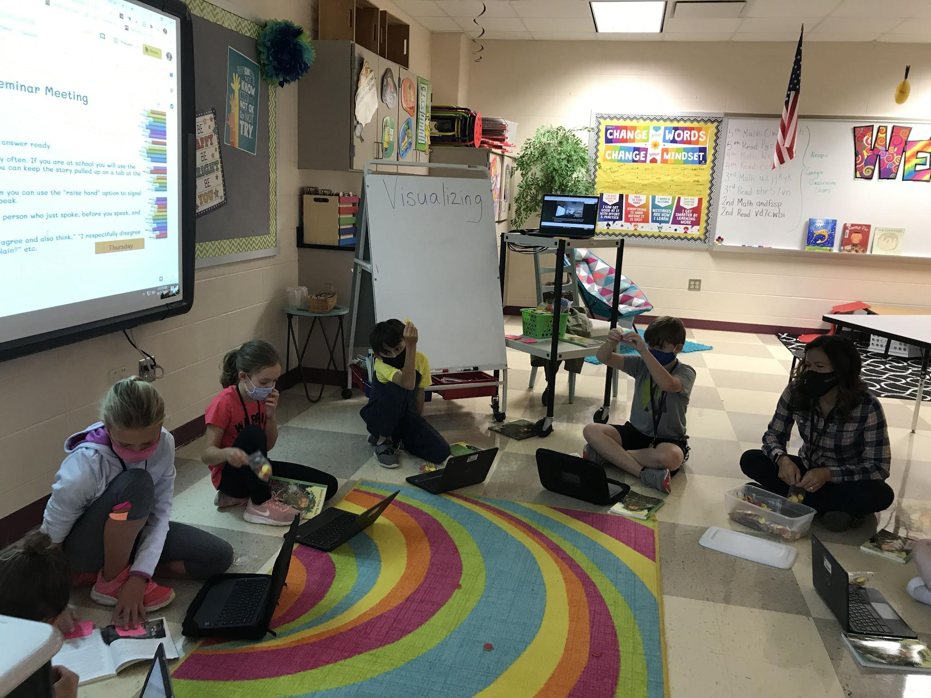
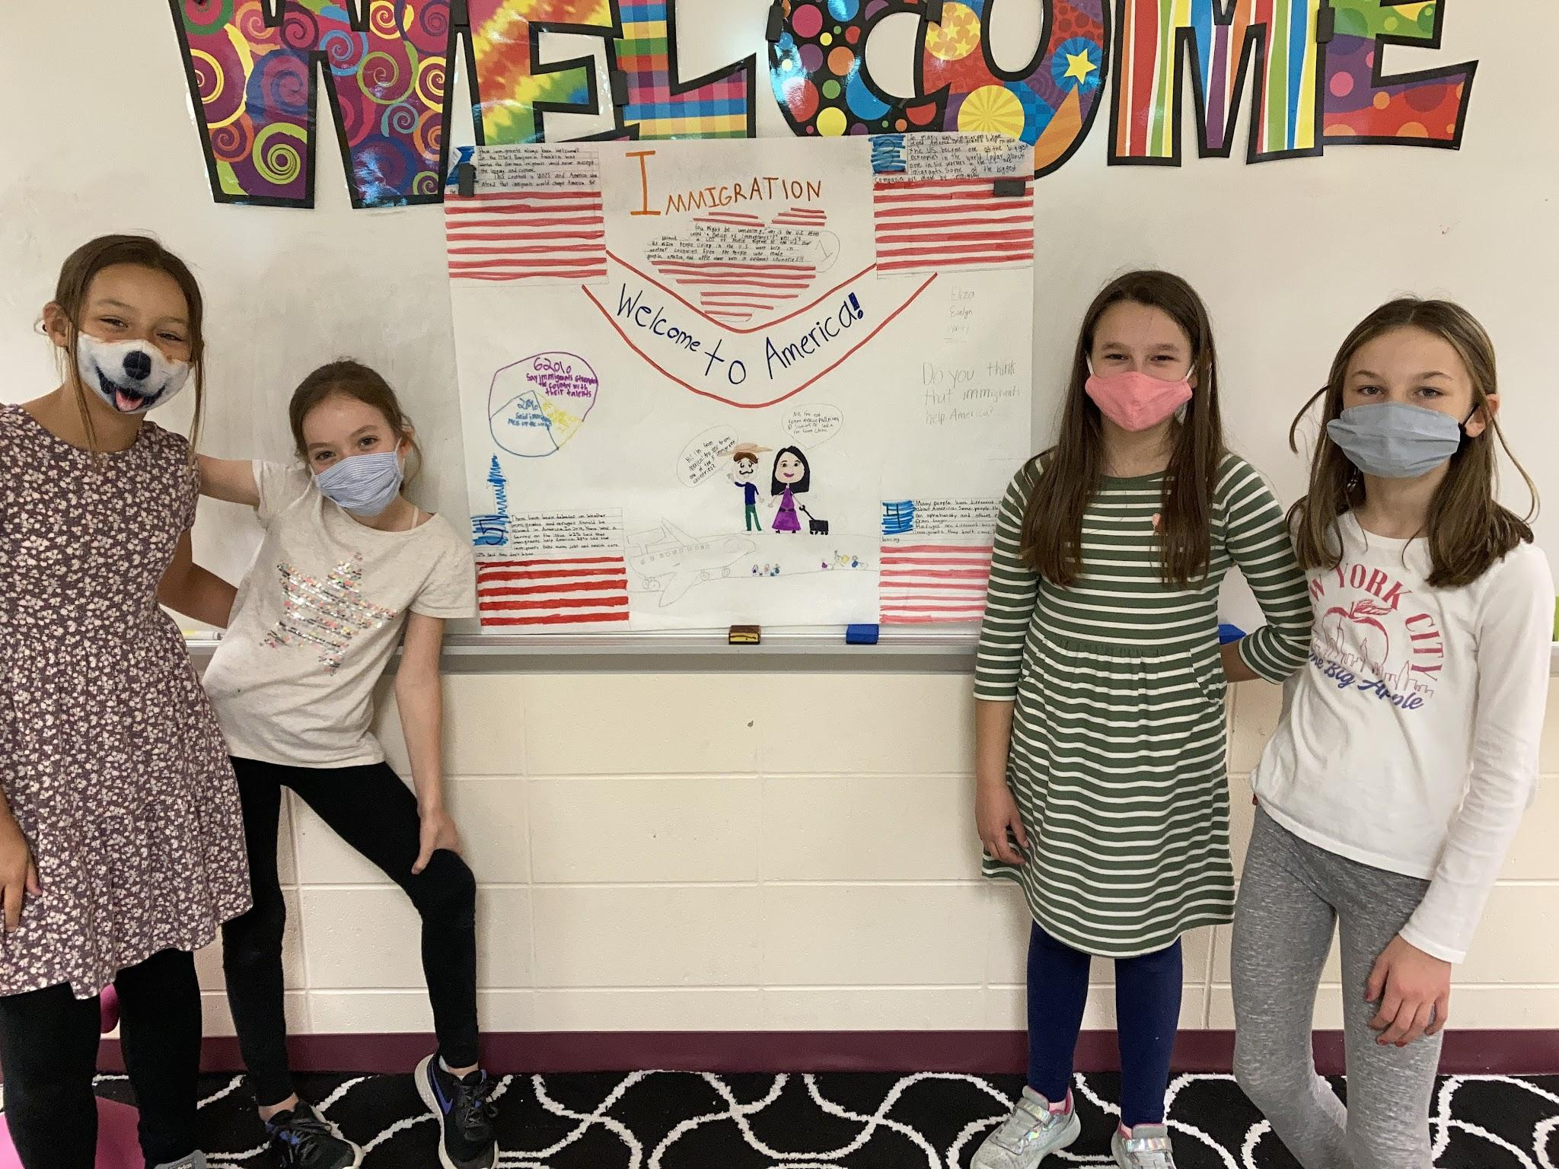
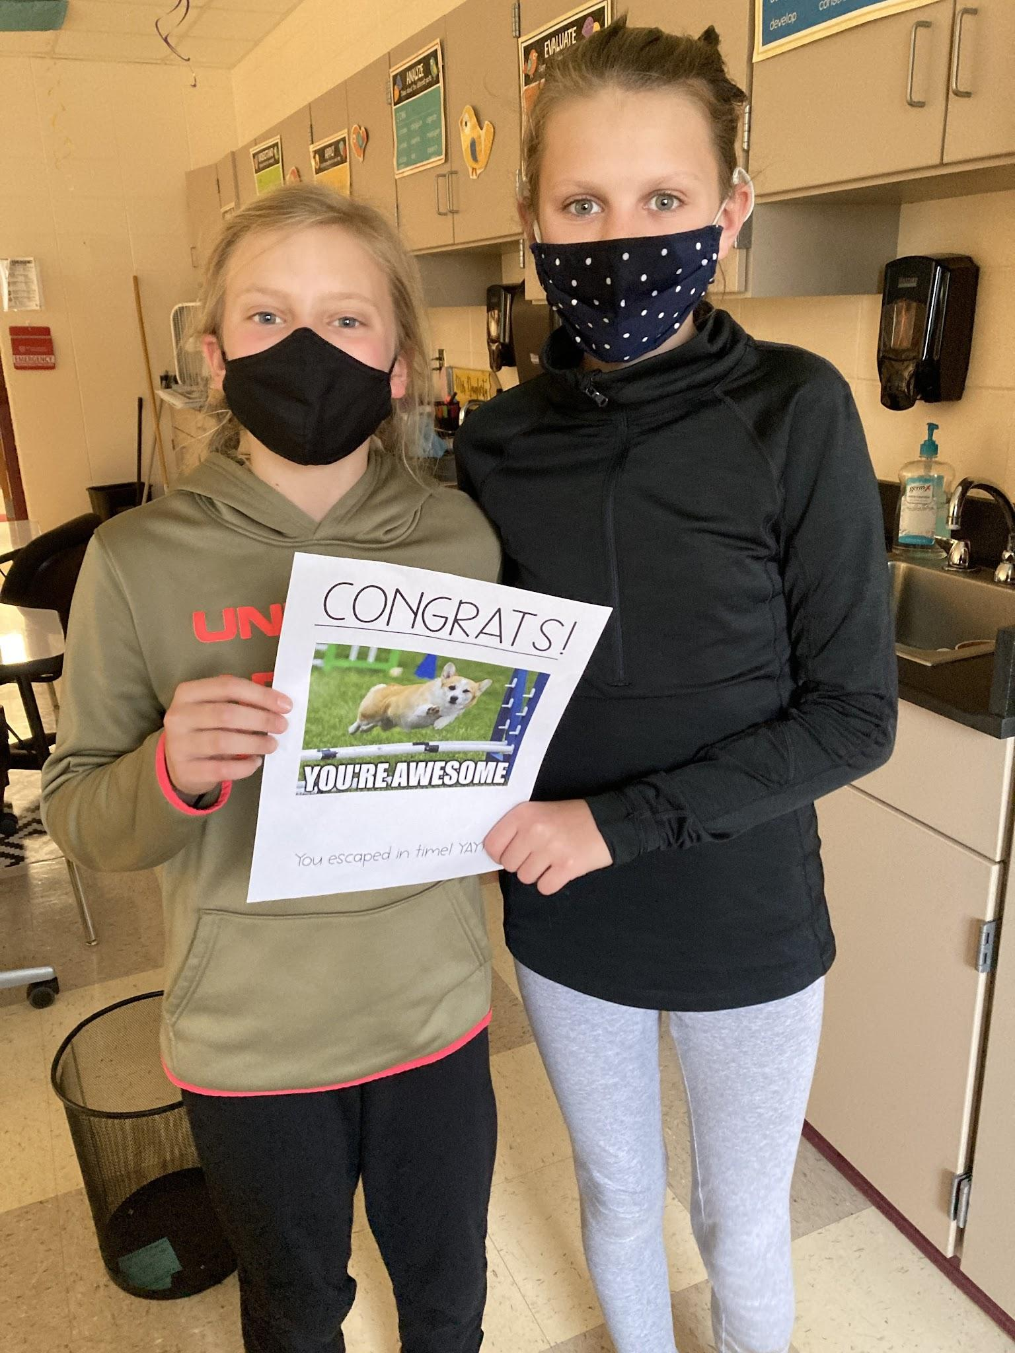
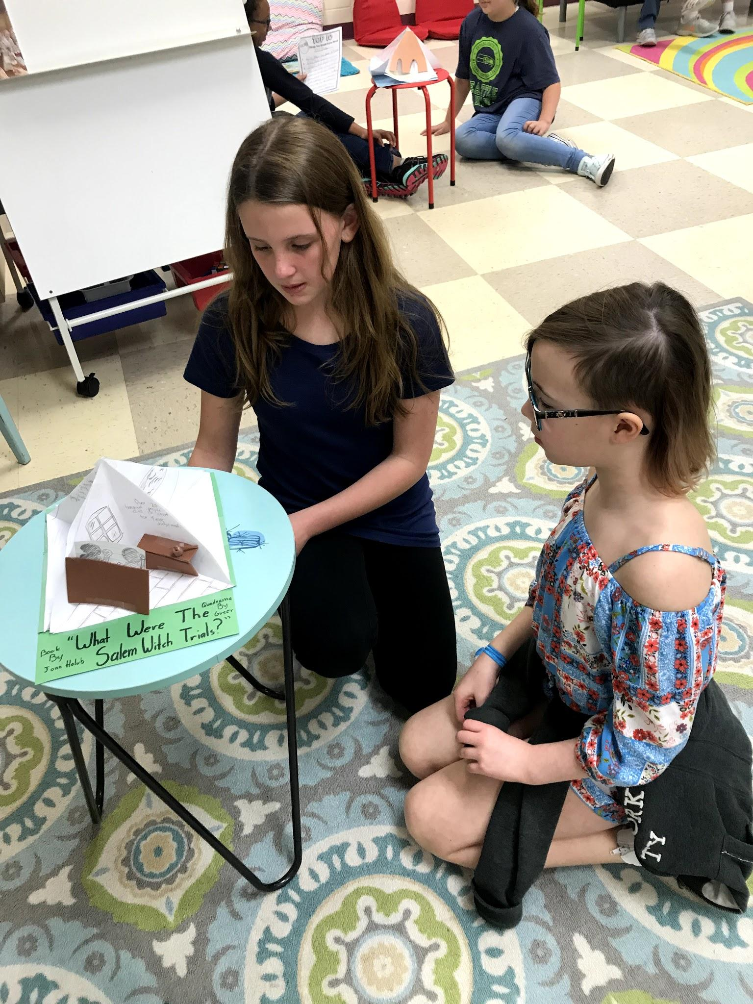
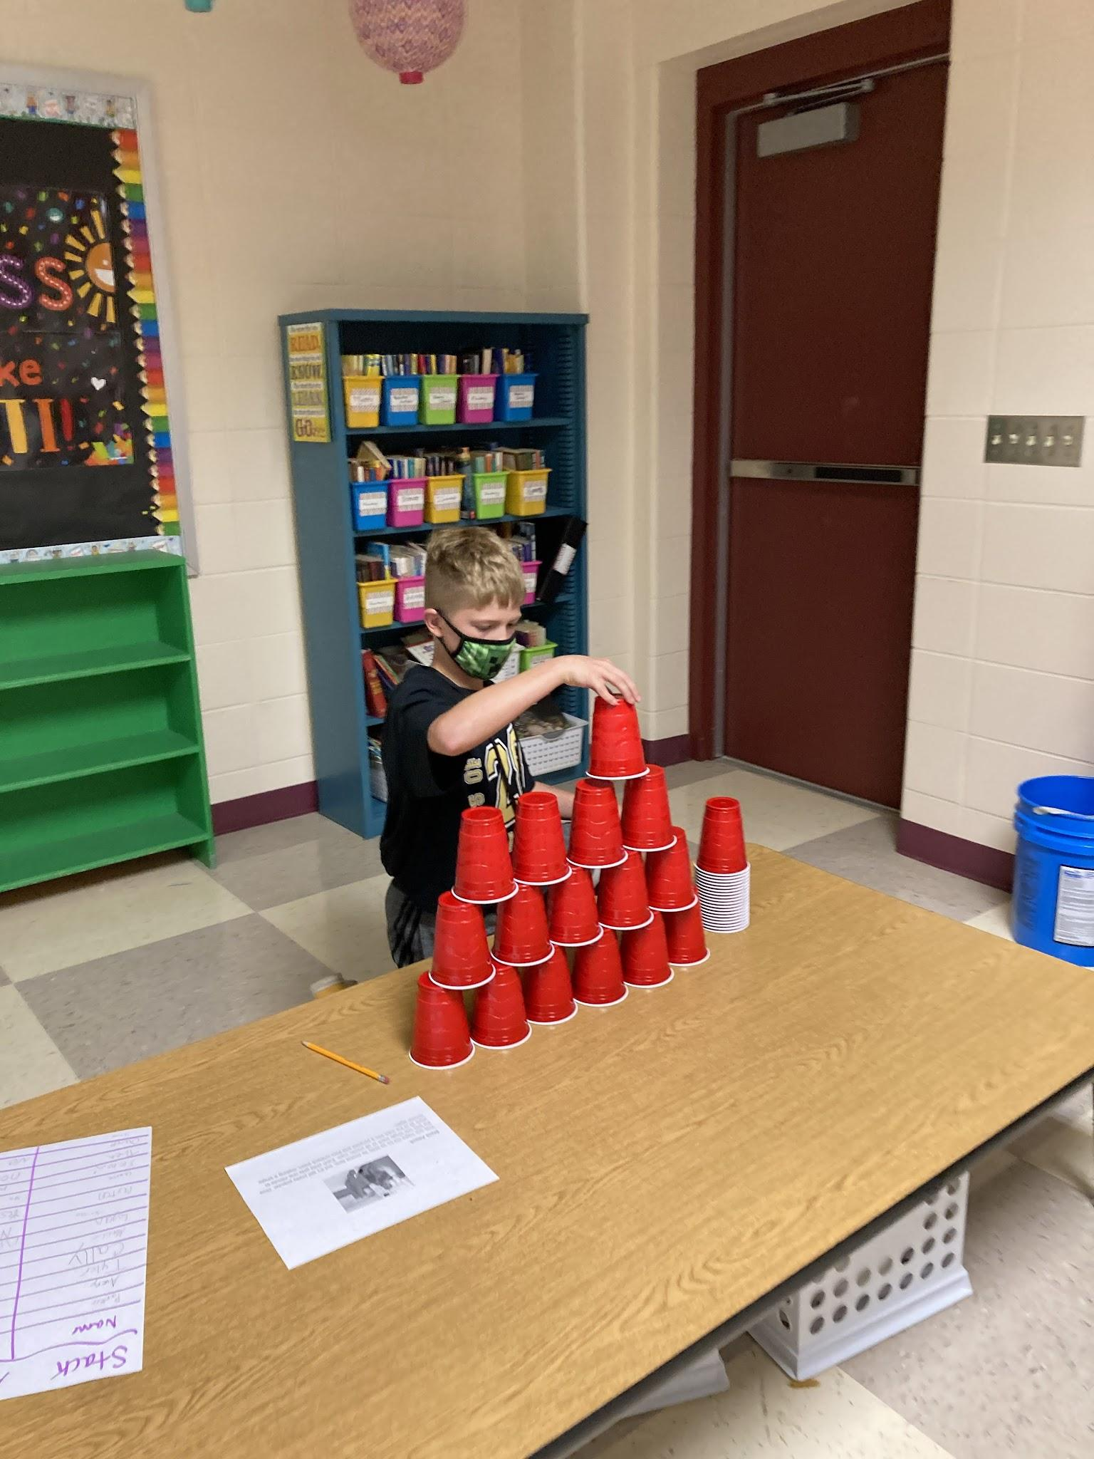
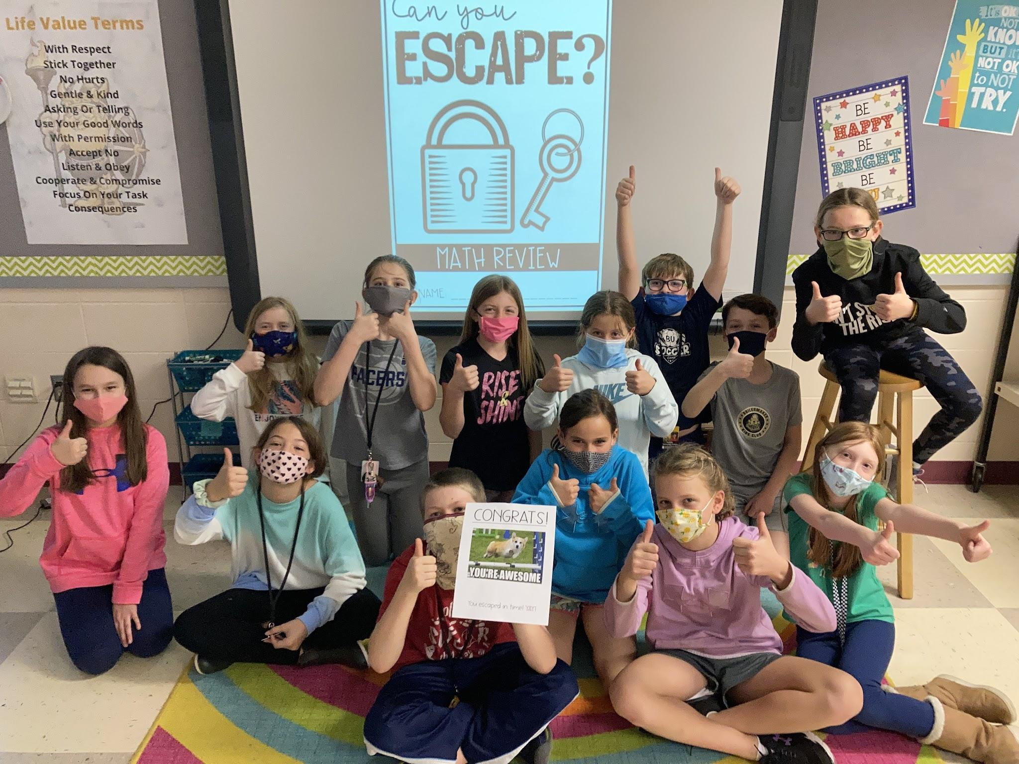
Creativity & Critical Thinking

Slide 12
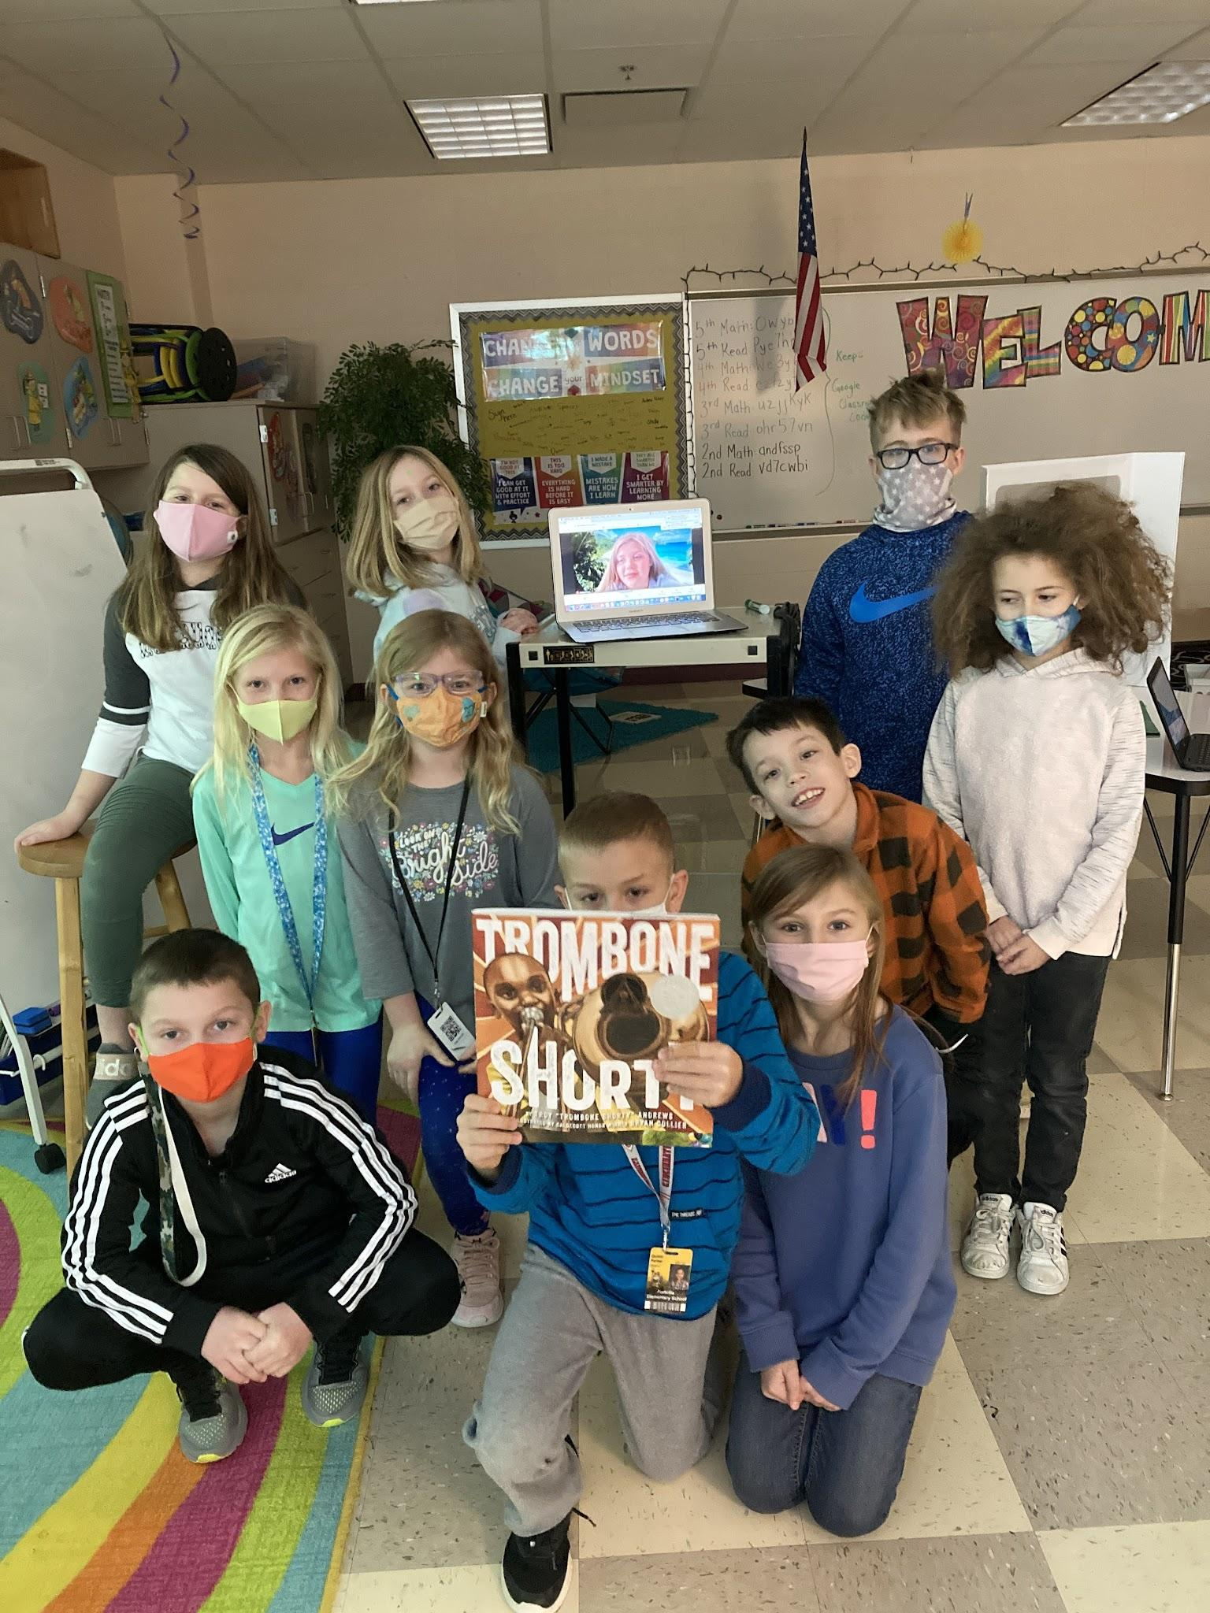
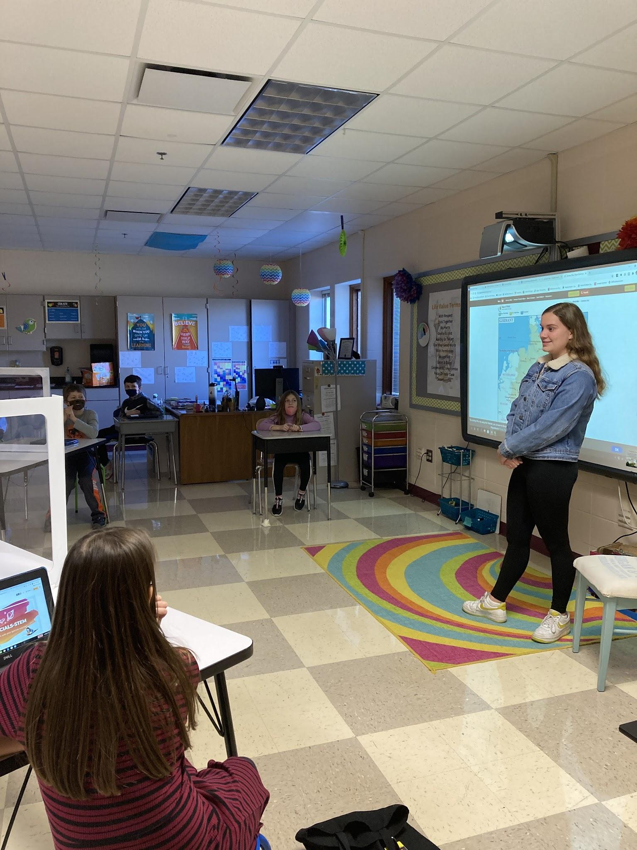
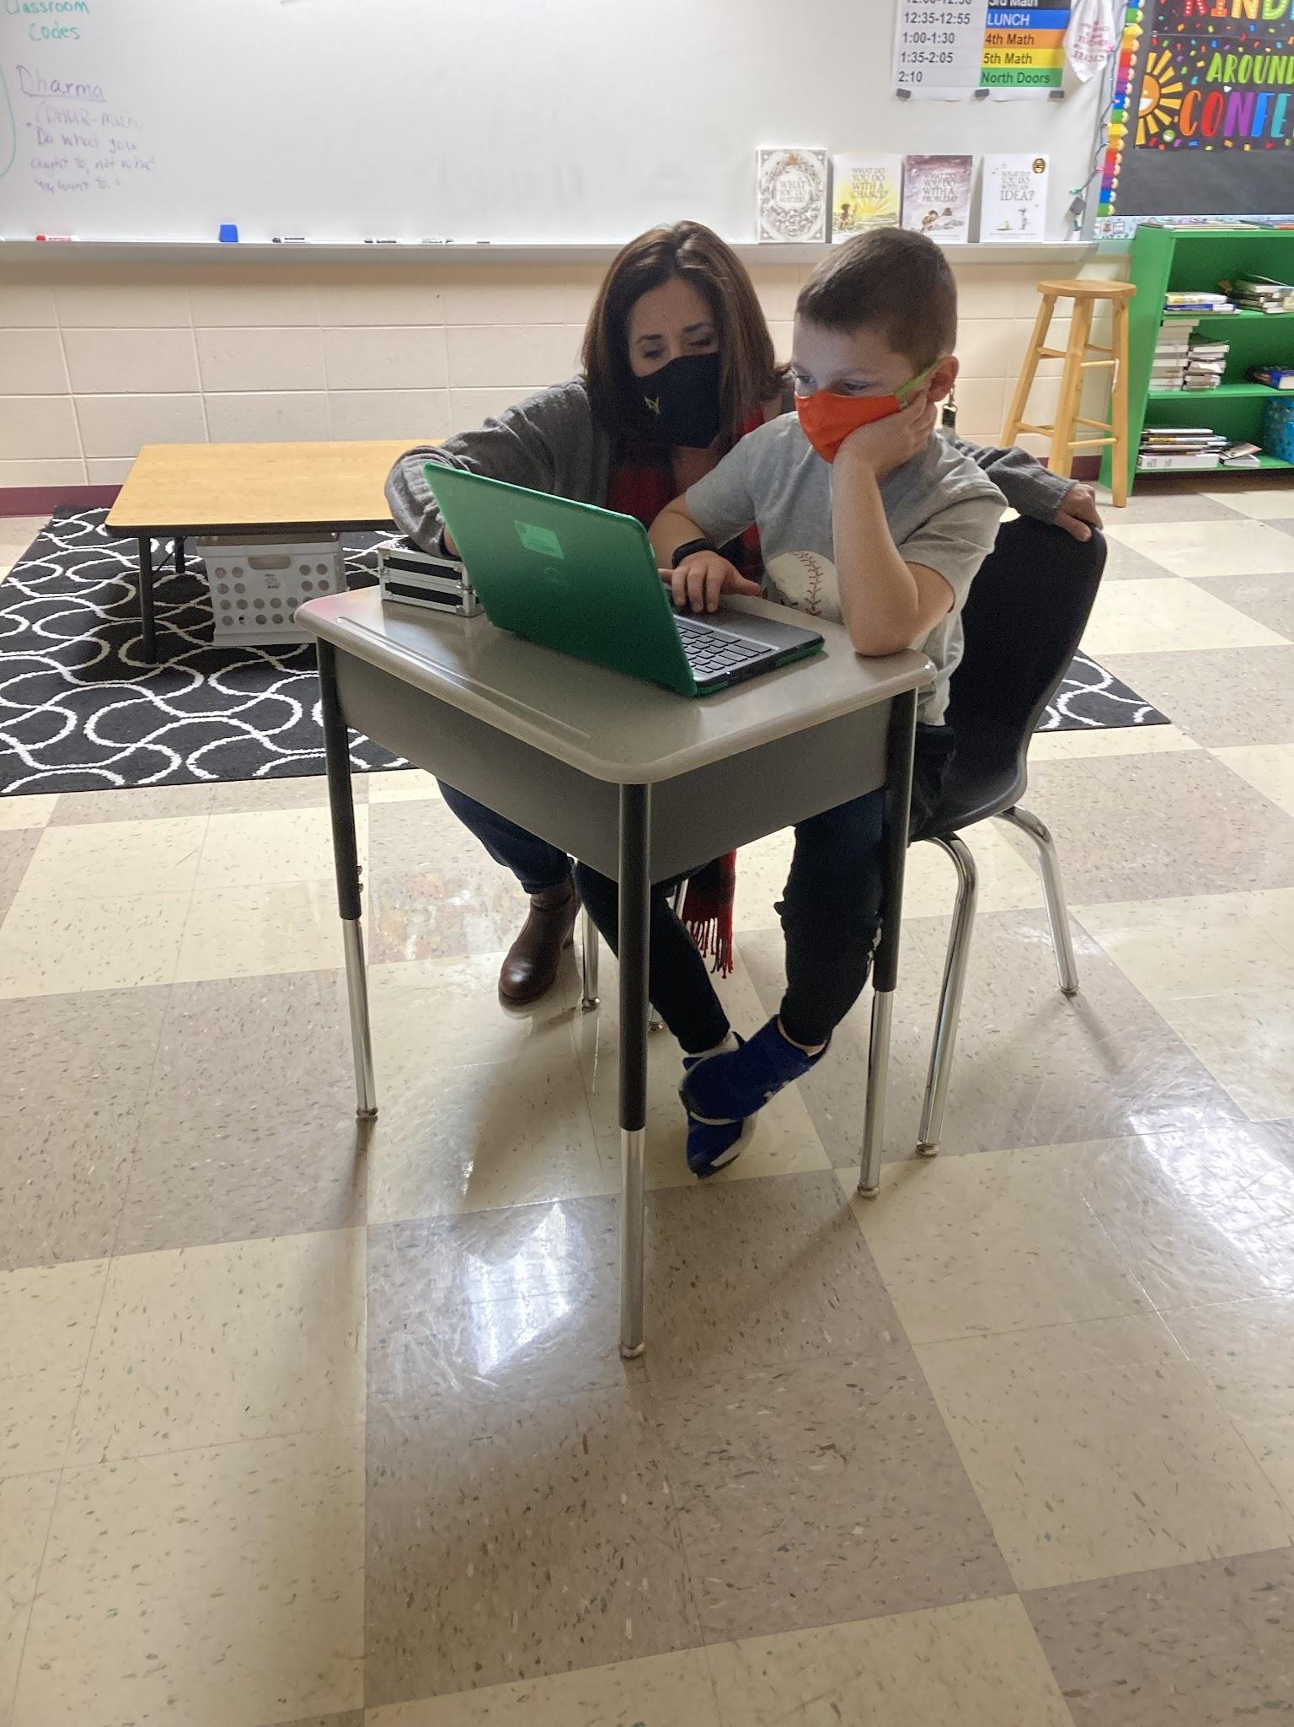
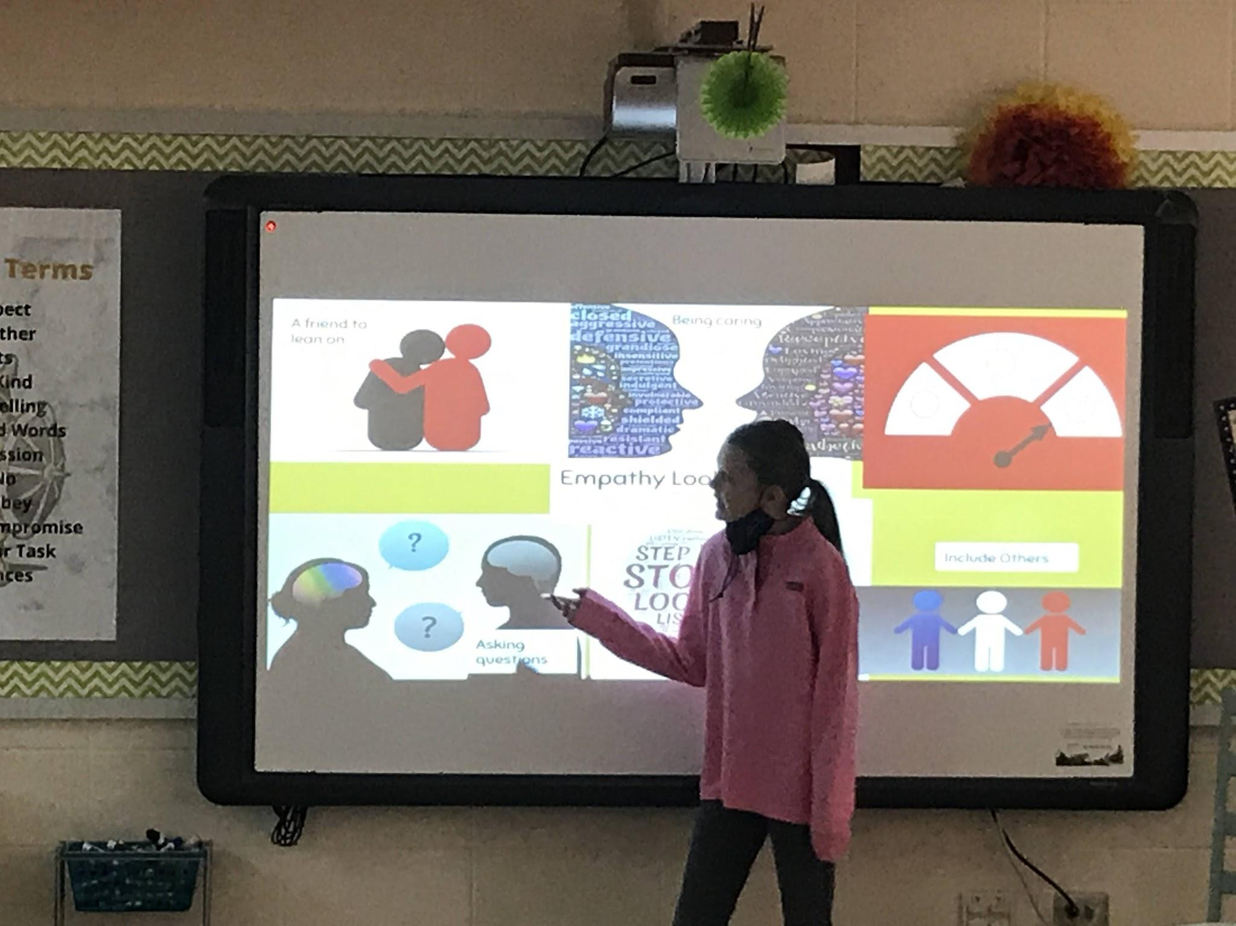
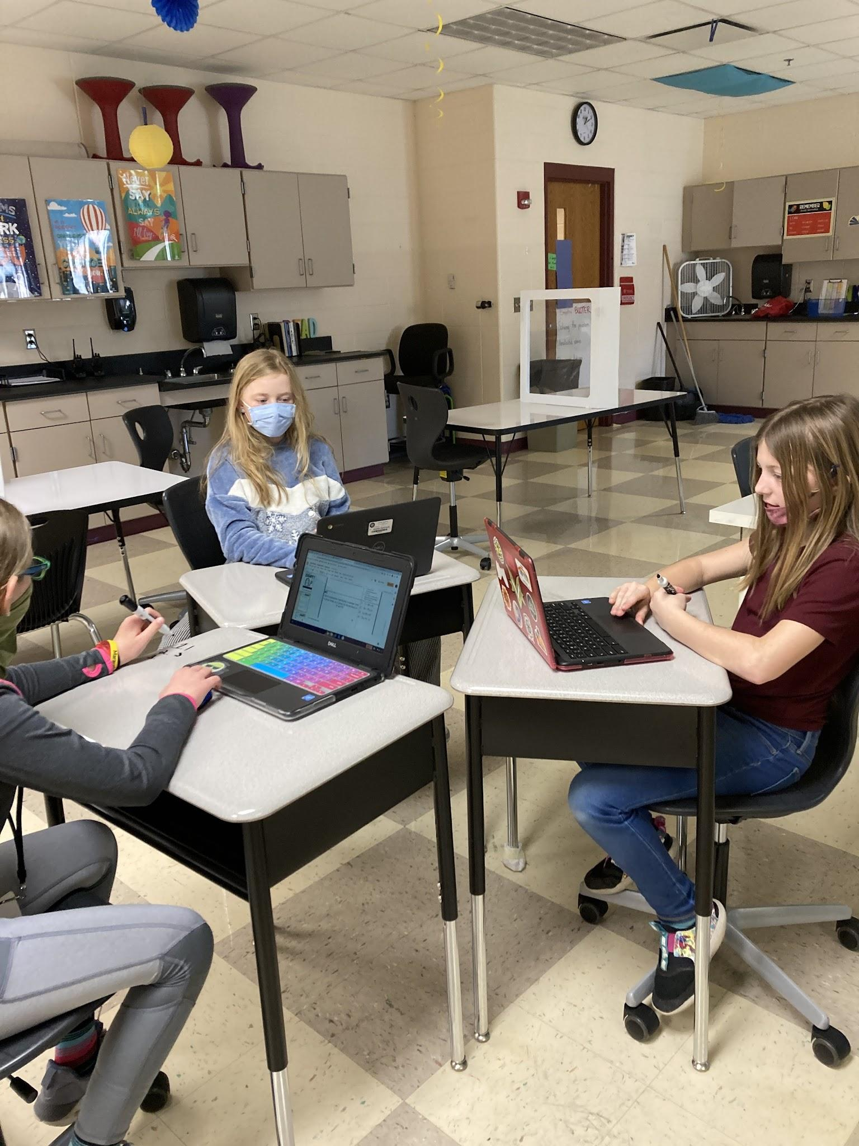
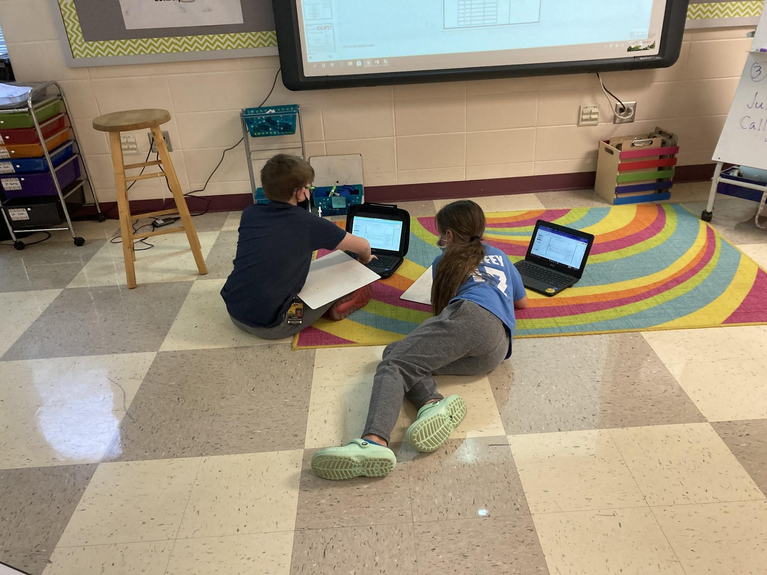
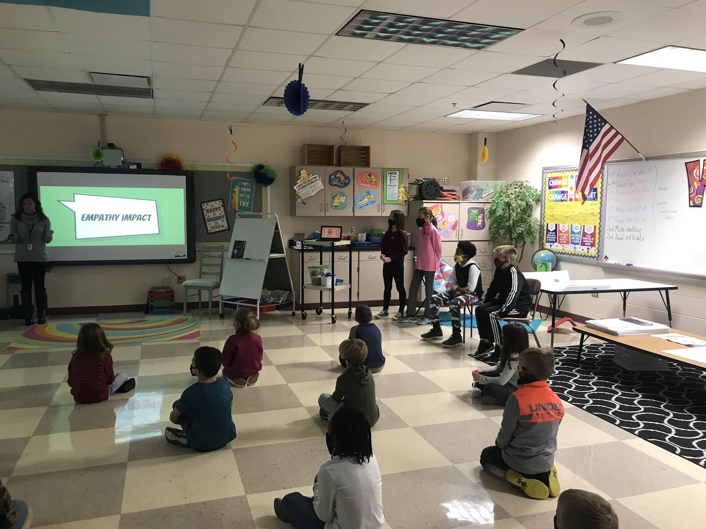
Collaboration & Leadership

Slide 13
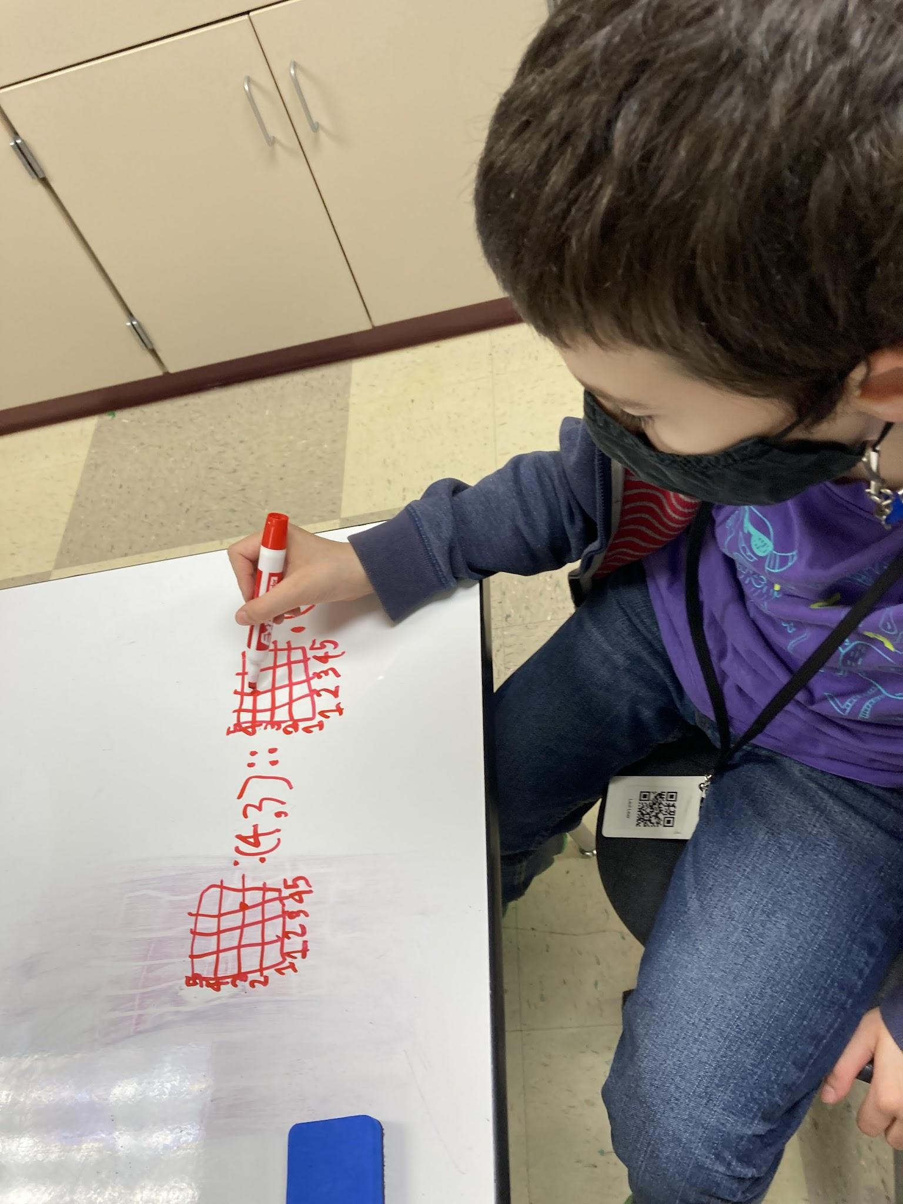
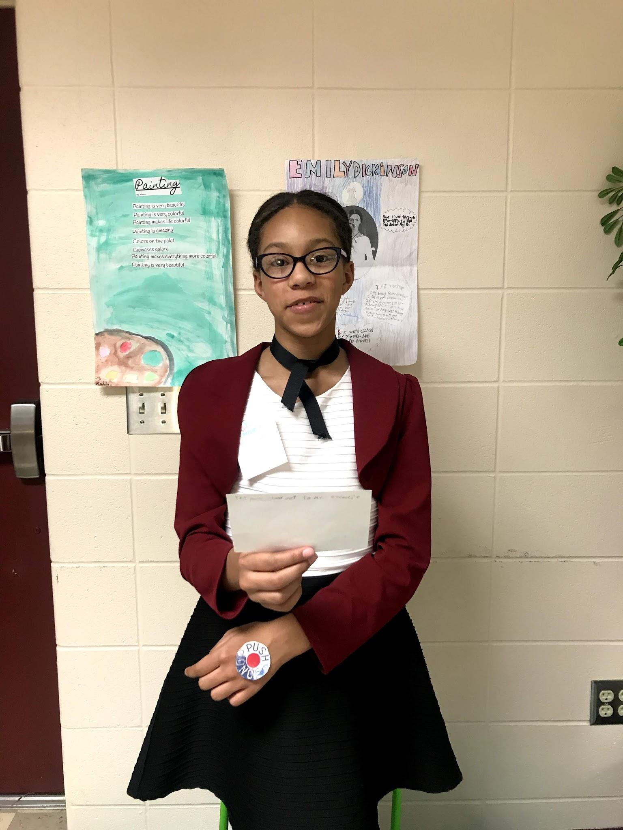
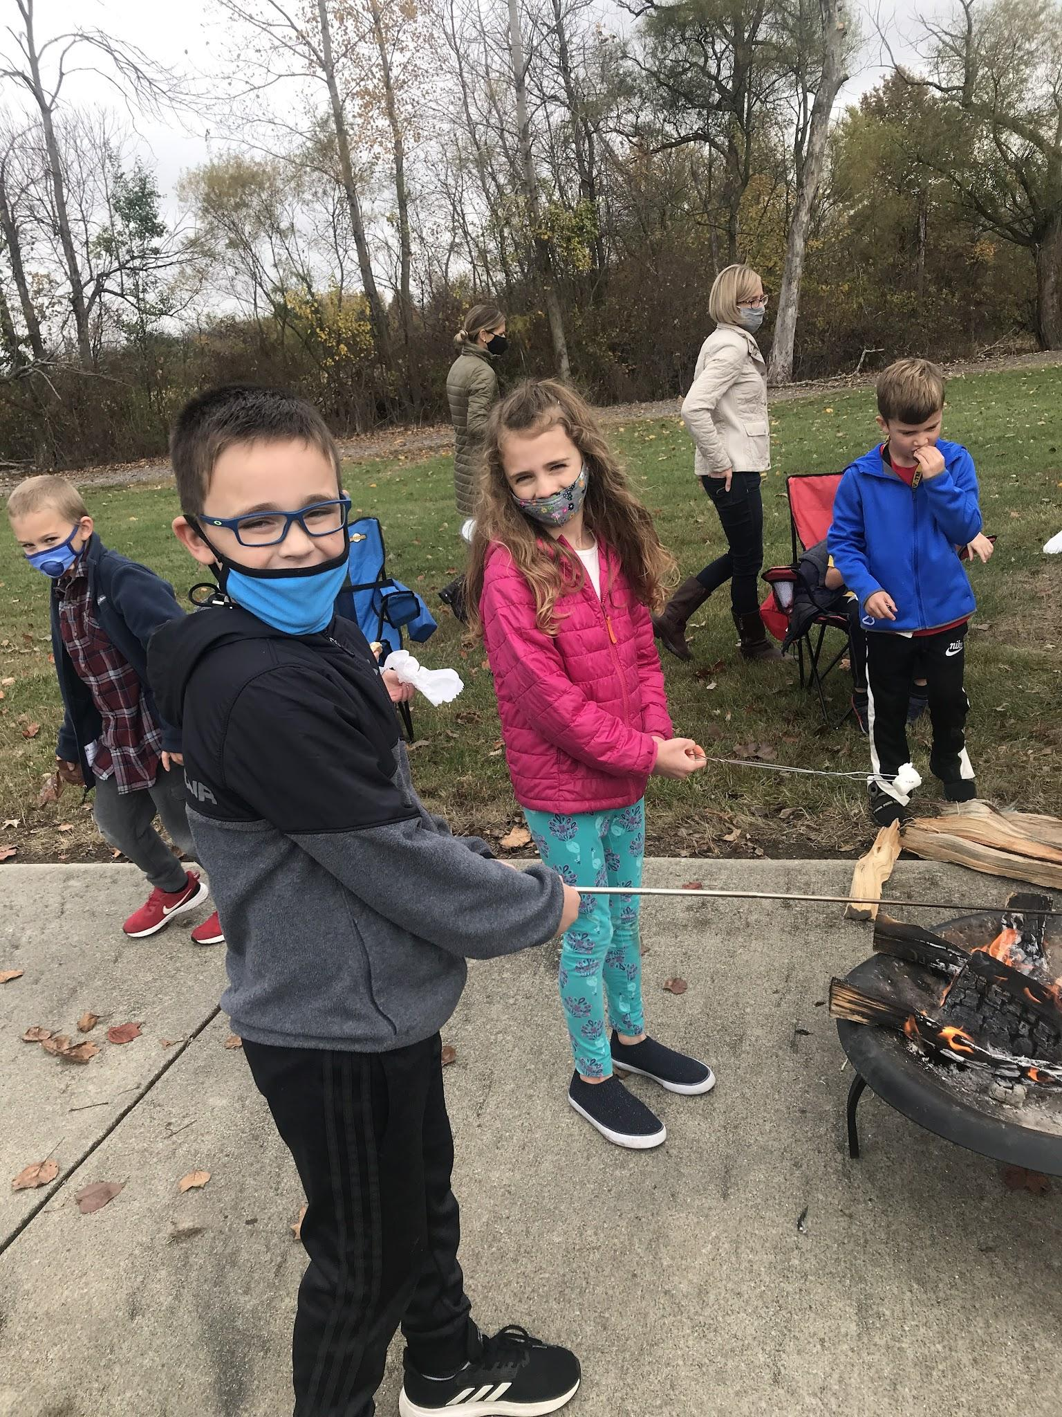
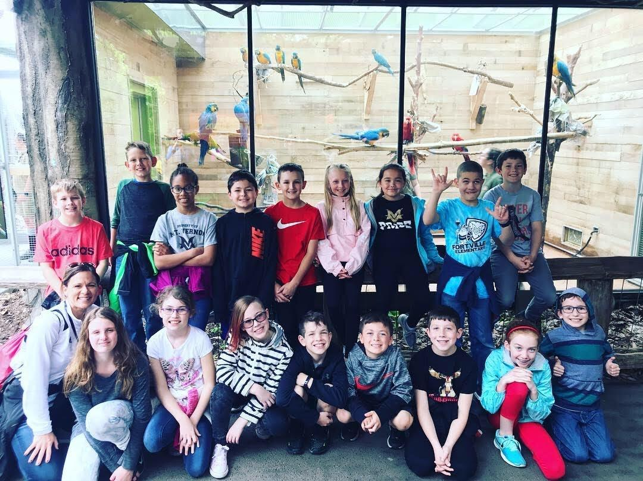
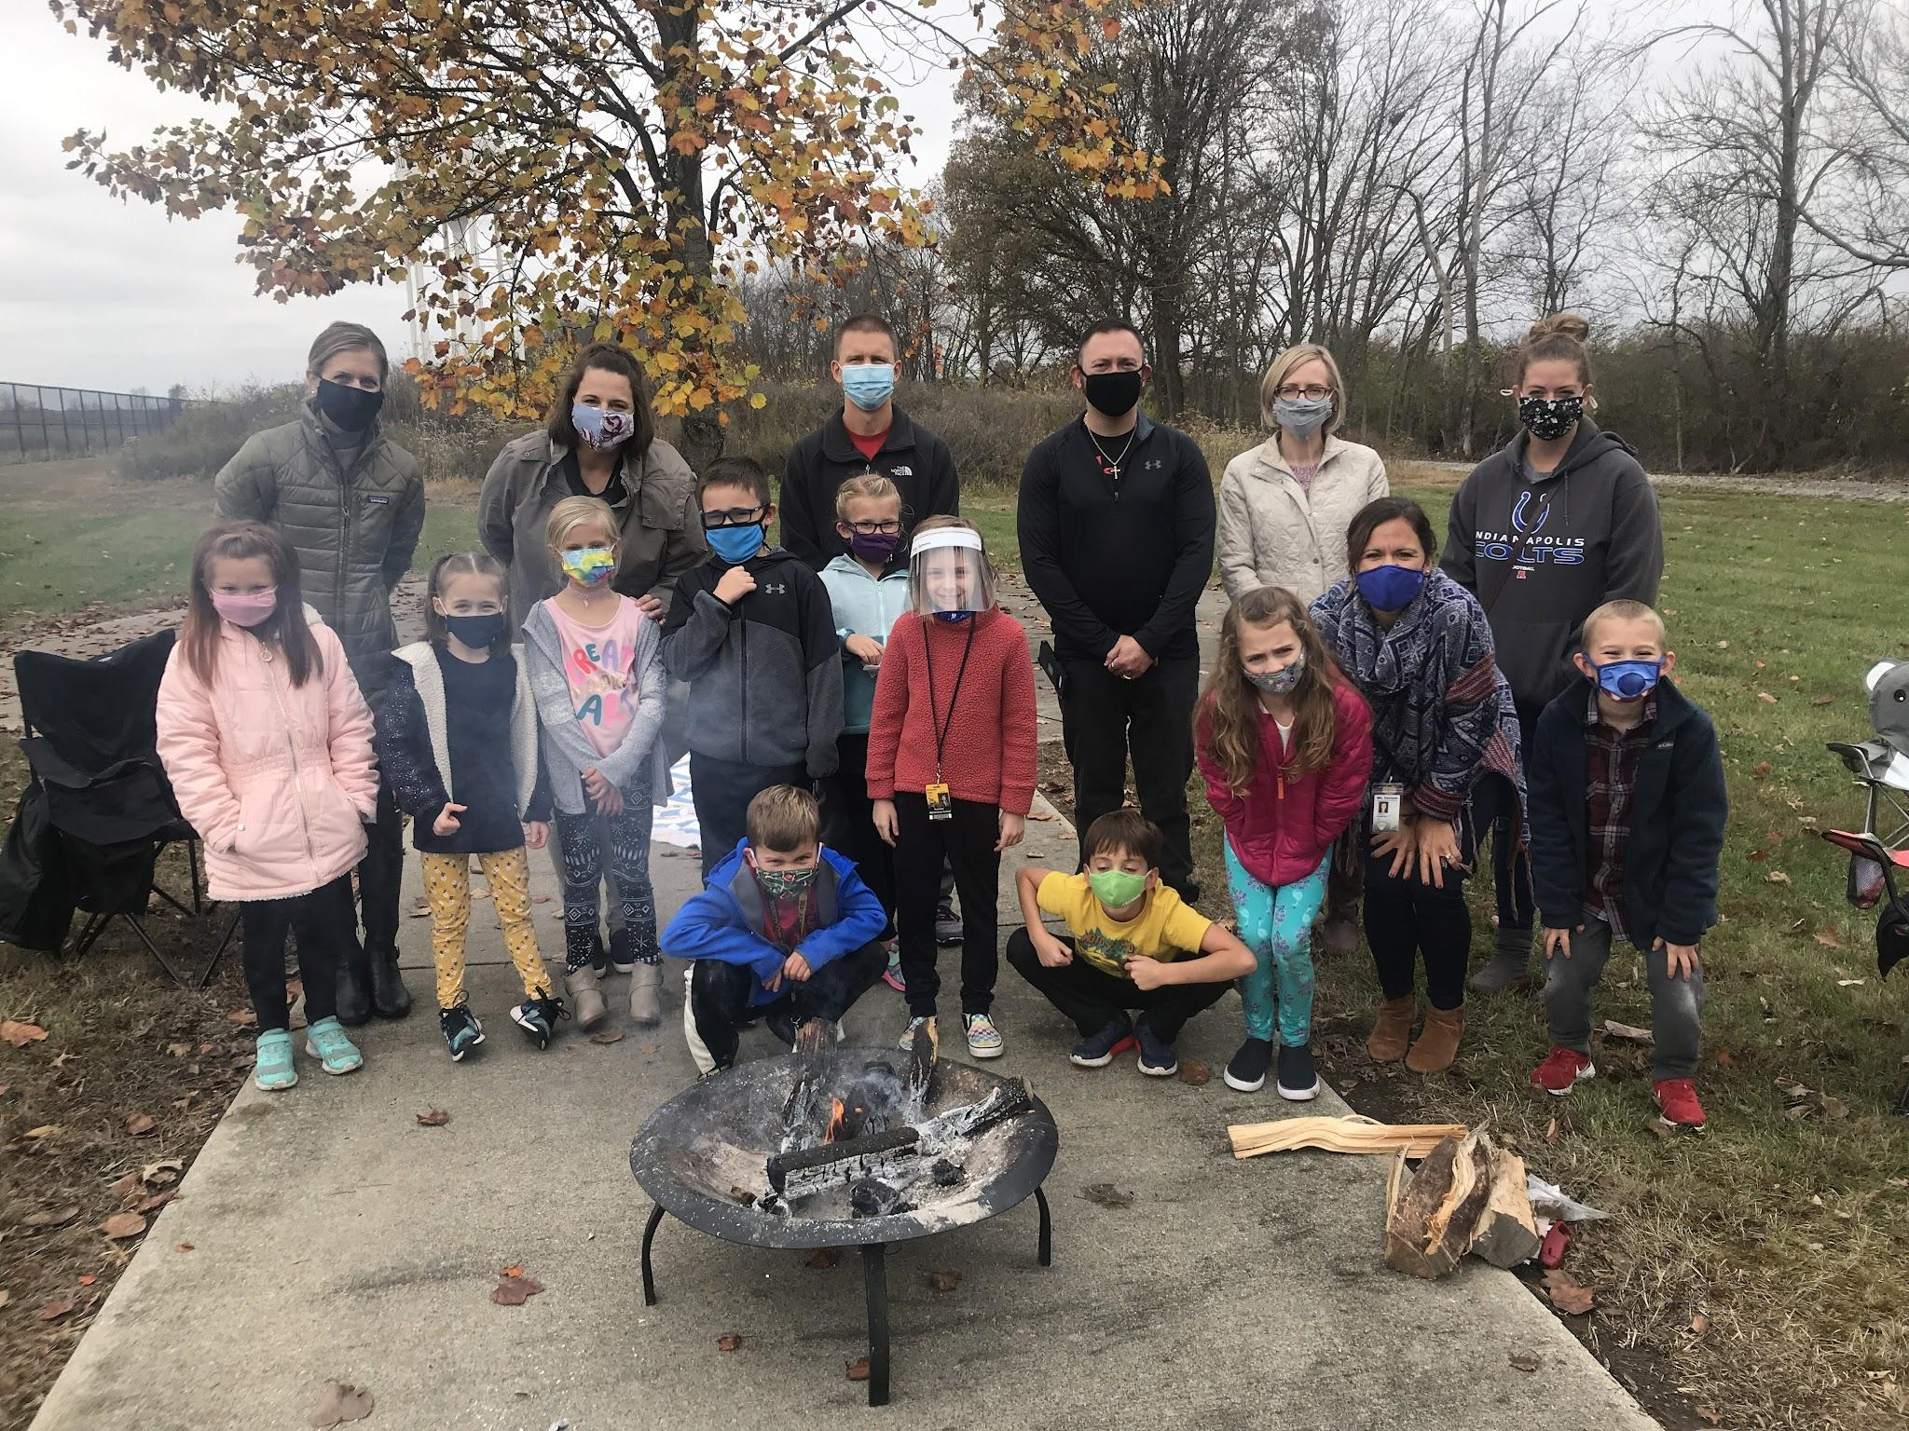
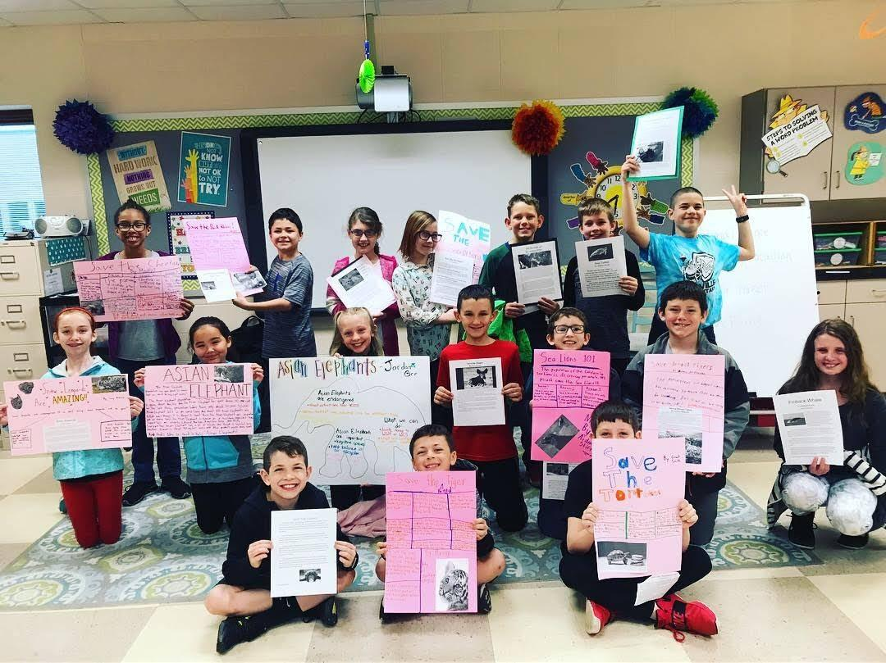
Acceleration & Project Based Learning

Slide 14
Guidance and Counseling

Slide 15
2021-22
Guidance and Counseling Smart Goal: equip guidance staff with tools to recognize and effectively support high ability students with non-academic needs.
How?
Parent University: SENG, Co-Presenters: Jessica Daugherty/Whitney Coake (DOE High Ability Coordinator)
SENG Facilitator training: high ability coordinator, elementary counselors, and MS/HS high ability counselors, fall 2021
Host quarterly meetings between guidance counselor and high ability coordinator to continue the conversation
Increase parent communication in regards to scheduling options, specifically MS/HS

Slide 16
Professional Development

Slide 17
2021-22
Professional Development Goal: Increase teacher efficacy specific to high ability best practices
How?
Continue annual cohorts for high ability licensure (K-12), currently at 11 (2 in 2016)
HA Licensed teachers placed in leadership positions, and cluster classrooms
HA Teacher modules, led by HA Coordinator spring 2021
DOE HA Webinars, Summer 2021 (funded by HA Grant)
Design co-planning and co-teaching opportunities between the high ability coordinator and classroom teachers
Current HA Instructional Assistant pilot for HA coaching support

Slide 18
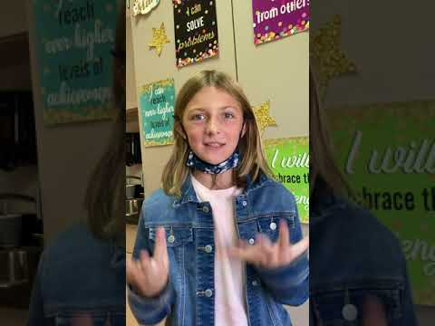
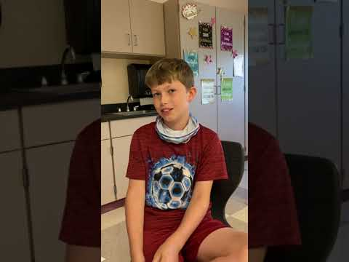
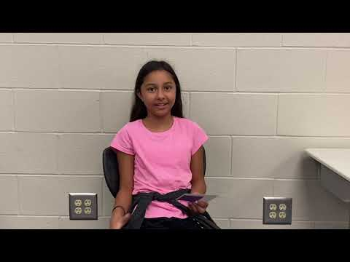
Thank you!

