Slide 1
Sign in with the QR code

Slide 2
Click to play in browser
Notes:
DIRECTIONS:
Play video on the slide.
If it doesn’t play, use the link on the slide OR copy and paste this in browser or send as follow up
https://www.youtube.com/watch?v=t7CnuHg4Ddk&feature=youtu.be
Now we’re going to get started with a quick video

Slide 3
Let’s go to…
Spain & France
✈
Madrid & Paris – 8 Days
Notes:
Welcome/ Thanks for coming to learn about this exciting opportunity for your child to travel abroad on an educational tour ____________ during _____________

Slide 4
Our agenda
What we are going to cover
Introduction
Our itinerary
What’s included
Our travel partner
Safety and support
Price and how to enroll
Notes:
SPEAKER:
[Intro]
First I’ll introduce myself and my background. I’ll also give you a quick intro to EF, our travel partner
[Our travel plans and tour itinerary]
Where we’re going and what we’ll be doing
[What’s included (and what’s not)]
The long list of items included in your tour
[Our Travel Partner]
EF is more than a travel partner; they support us in so many more ways which I will tell you about
[Safety & Support]
We’ll go over safety, EF’s top priority, and how EF supports us in the whole process from planning to traveling
[Price and Enrolling]
We’ll go over price and wrap up the meeting by opening enrollment and submitting your questions using the sign in form!
And with that, let’s dive in!
GOAL:
Let families know what’s in store
Make it clear there will be no group Q+A (questions through sign-in sheet only)
Keep meeting short to respect their time

Slide 5
My name is
I have been traveling with EF for over 20 years–this will be my 8th EF trip. I have been teaching English at MVHS for 18 years
Notes:
SPEAKER:
[First just a little about me…]
I teach…
I’ve worked at the school for ___ years

Slide 6
Why I travel…
Notes:
SPEAKER:
Travel is important now more than ever and I really want all of you to have this experience of a lifetime
GOAL:
Show students and families your passion for travel– the amazing things you’ve seen and the transformation that’s happened along the way OR your excitement about having new experiences with the group!

Slide 7
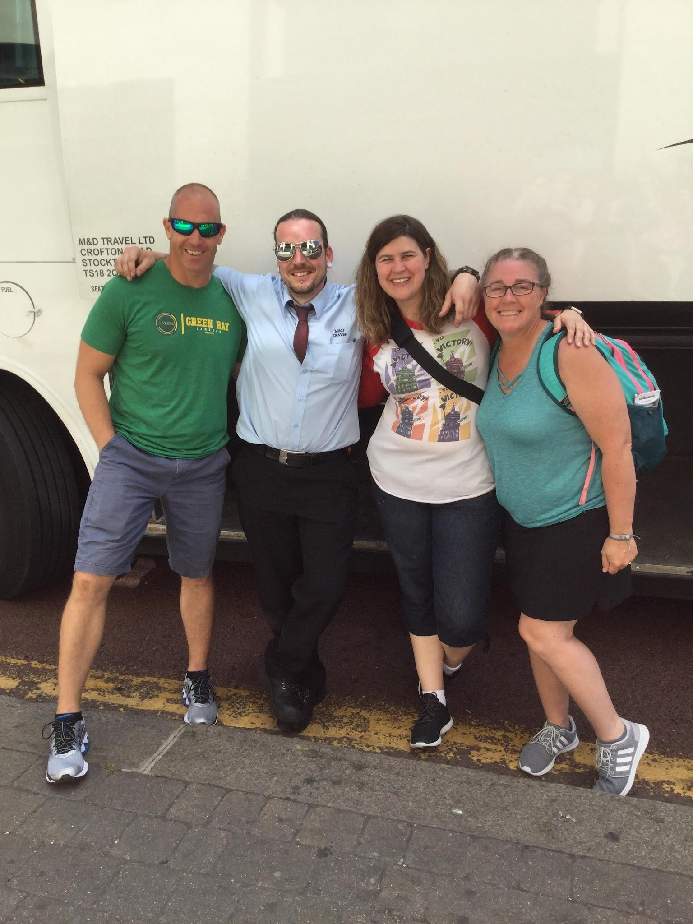
My name is
Danielle Stindle
This will be my 4th EF tour. I have been teaching English at MVHS for 19 years. My husband, Kevin Stindle, usually travels with us as well. He is a paramedic.

Slide 8
EF Educational Tours
Our educational travel and safety partner
Notes:
SPEAKER:
Before we dive into the incredible itinerary we’ve selected for our trip – I want to talk about our travel & safety partner.
I’ve chosen to partner with an organization called EF Educational Tours for two key reasons (insert YOUR reasons for choosing EF)
[55+ years]
They have 55 years of experience which means they have seen it all and know how to respond.
[Staff on the ground in over 50 countries]
EF always knows what is happening on the ground which is critical in an everchanging environment
They know how to safely navigate a city as true locals
They have an office close to us on tour in case we were to need extra support
[World Leader in international education & accredited]
EF is an accredited educational organization, just like our school. We’re going to have fun but also learn a lot too!
I feel extremely confident that partnering with EF is the best way to stay safe and healthy while having a life-changing experience. I’m going to go into more detail in a couple slides!
To Learn More:
To learn more about EF, everything you need can be found on our tour enrollment page, which I’ll share with you at the end of this meeting.
GOAL:
Explain YOUR reasons for partnering with EF, to start to build trust in EF.
Mention EF’s experience, worldwide presence, and educational focus.

Slide 9
Paris and Madrid

Slide 10
Day 4
Day 5

Slide 11
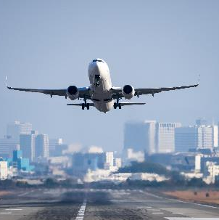
Day 8

Slide 12
See the iconic
Eiffel Tower, of course!
Add large beautiful images
Notes:
SPEAKER:
Directions: Read from slides
PURPOSE:
Hypes up and reminds students and parents why they want to enroll!

Slide 13
Visit the official residence of the
Spanish royal family
Notes:
SPEAKER:
Directions: Read from slides
GOAL:
Hypes up and reminds students and parents why they want to enroll!

Slide 14
And don’t forget
about the food
Notes:
SPEAKER:
Directions: Read from slides
GOAL:
Hypes up and reminds students and parents to enroll!

Slide 15
Our Travel Dates
Notes:
Our Travel Dates
Because we are planning early, and because we want to get the best experience possible, we need some flexibility when it comes to travel dates. With that, we have a travel date range, which means we could be leaving as early as _____ and returning as late as______.
We will find out our exact dates 2-3 months before tour, but for now we could be traveling any time within that range.
Also to note, in the middle of that range falls ______(requested dates). You will see these dates as you enroll, but again, note that you could depart for your trip as early as _______ and return as late as _______.
We also have the chance of traveling with another school, which would be a great experience to meet other students!

Slide 16
What’s included in our itinerary
Regional-style meals for breakfast and dinner
Notes:
SPEAKER:
[So, what’s included?]
A TON
Directions: read through each one.
GOAL:
Build the value in the experience, through everything that’s included
You want parents to think the will cost twice as much as it actually does

Slide 17
What you are responsible for
Passports (and visas, if applicable)
Baggage fees
Tips for local guides, bus drivers and your Tour Director
Snacks and some meals
Notes:
[Not included]
A few things. But no real surprises here.
As we get closer to departure I’ll hold a meeting for our enrolled travelers to talk through passports, tips, etc.

Slide 18
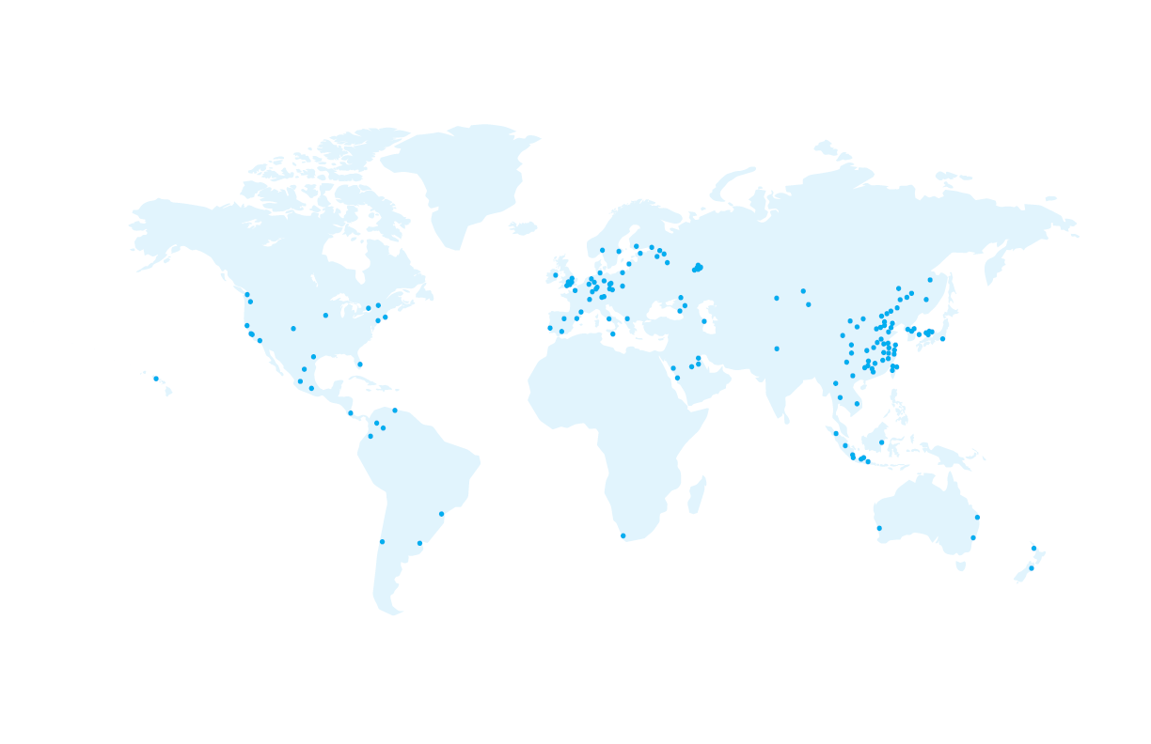
Why I partner with EF…
Notes:
EF is SO much more than just someone who books our flights and finds our hotels. Here are a couple reasons why I partner with EF………..

Slide 19
Our safety partner
Local support and insight worldwide
EF’s Safety and Incident Response Team
Rigorous health standards
24/7 Tour Director and chaperone team support
Notes:
SPEAKER:
Let’s talk about safety. I’ve done my research and feel incredibly confident partnering with EF.
Sample Talking Points:
EF has our back, they’ve thought of everything, and I trust their safety policies
They have multiple programs in place to help keep us safe
EF will be right there to support us (locally, globally, pre-tour and on-tour) to help us through any situations that arise
Bottom line: we are safer traveling with EF than we ever would be on our own.
They have policies to protect our investment pre-tour (which will cover in a minute), but they also provide us with a lot on tour:
[Local support and Insight]
As you have already seen, EF is a global company! Because of this, EF has local knowledge to keep our groups safe no matter where we are in the world.
[Safety & Incident Response Team]
• EF’s has a team of experts located around the world, their #1 priority is safety
• They are always ready to respond to ensure that a train strike or a sprained ankle won’t slow us down
Their emergency support team is available 24/7, 365 days a year
[Rigorous health standards]
EF has enhanced safety precautions and procedures that cover everything from cleanliness to adjusting tours as needed.
[eyes and ears on the road]
• In traveling with EF, there is a support team, from our Tour Director to myself, to my chaperones
GOAL:
Continue to build trust in EF
Help parents understand how we help keep students safe

Slide 20
Our education partner
The best way to help students gain new perspectives and build skills for the future is through experiential learning
EF’s Personalized Learning Guide
This guide helps students put a more personal lens on their tour by tapping into their own interests and passions.
High school or college credit
Students can earn 0.5 high school credits (included) or 3 college credits (for a small fee) by doing additional project work related to their tour experience.
College essay
help
EF’s college essay guide helps students use their tour as inspiration for a personal essay that admissions officers can’t resist.

Slide 21
Come home changed
EF's learning outcomes continue to impact students for the rest of their lives
Growth Mindset
Students will learn to embrace new challenges
Global Perspective
Students will expand their world view
Personal Development
Students will discover more about themselves
Action & Impact
Students will gain necessary skills to make an impact
Learn more at eftours.com/education
Notes:
SPEAKER:
[So, what’s G2PA?]
EF has 4 main learning objectives to ensure that our students come home a more prepared global citizen than they were before they went on their EF tour
Directions: read through each one.
GOAL:
•Build the value in the experience as more than a vacation
•This is a transformative educational experience that will prepare them for their future

Slide 22
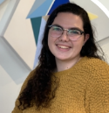
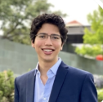
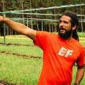
Our support partner
Notes:
Our Support Partner!
EF supports us in so many ways, and here are a few key players that help make our tour exceptional.
There are people at EF like my personal tour consultant, and their travel support team that help us prepare for tour. My tour consultant helps me every step of the way from planning this trip, to getting you all involved, to getting us prepared to depart. Our Traveler Support Team is there for you all to answer any possible questions you may have, from payments to dietary restrictions, and more.
While on tour we have our Tour Director leading the way and of course I will also be there with my chaperones to help support the students and all of you back home.

Slide 23
Book with confidence
Risk-free enrollment period
Travelers who enroll now can cancel for any reason 14 days after enrollment for a full refund of 100% of the money paid to EF.
Notes:
SPEAKER:
EF is offering a few things to help us protect our investment, to give us the confidence to book our travel experience now, while monthly payments are so affordable. Here are some of the ways that EF is protecting our investment:
[Peace of Mind]
EF’s Peace of Mind Program gives our group the flexibility to modify our tour or dates if we’re uncomfortable traveling as we get closer to departure.
[Global Travel Protection]**
Custom-designed travel protection unique to EF, provides both pre-tour and on-tour benefits.
(if included): I have built that into everyone’s experience to give you additional coverage
Global Travel Protection Plus is available to you the day you enroll as well
[Risk-Free Enrollment]
New travelers who enroll can cancel for any reason up to 14 days after enrollment for a full refund of 100% of the money paid to EF.
I hope these programs help give you all comfort and confidence to enroll on this experience now. If you want more information on ANY of these programs, I'll be sending out all the details after this session.
For More Information:
If you want more information on ANY of these programs, you can read all the fine print on our Tour Enrollment Page which I’ll be sharing at the end of this meeting.
GOALS:
Help parents understand that their investment is protected

Slide 24
Making it happen
Global Citizen Scholarship
This scholarship is designed to help students discover the world—and their place in it.
EF awards up to $100,000 in scholarships each year
Needs- and merit-based
Any enrolled traveler may apply
Customizable Tour Fundraising Page
Every traveler who enrolls will receive an individual tour fundraising page.
Anyone can contribute! Send your fundraising page to friends, family, and loved ones
100% of all contributions made will go directly toward your tour balance
Notes:
SPEAKER:
EF offers a few additional opportunities to help fund our travel as well.
[Global Citizen Scholarship]
$1,000 needs & merit-based scholarship
To be eligible, complete application and submit a 2-3 minute video on how will this tour change the way you think, feel, or act about the world?
The 2022 Global Citizen Scholarship applications will open in Feb 2021; visit www.eftours.com/global-citizen for more details
[Personal Tour Fundraising Page]
Once you enroll, you can send out your personal tour Fundraising URL from your traveler page.
This page works just like a “Go Fund Me page” but better because you see 100% of the contributions applied to your tour balance
Great for holiday/birthday gifts, payment for baby sitting/mowing lawns, or just sending to friends/family who want to help you see the world!
GOAL:
There are a lot of supplemental funding options available to families to budget!

Slide 25
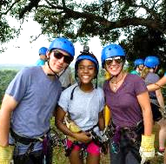
Itinerary & logistics
Payments & protection
Safety & support
Personalized learning
Everything we talked about getting on tour!
Flexible payment options
Personal Tour Fundraising Page
Global Travel Protection Plan included
Personal traveler account online
Traveler Support Team
24/7 Safety & Incident Response Team
Peace of Mind Program
Project-based learning guide
High school and college credit options available
College essay help
Notes:
Like I said, we get SO much more by traveling with EF beyond our itinerary and logistics, we have options for payments and protection, amazing safety and support, and personalized learning opportunities for everyone

Slide 26
Notes:
SPEAKER:
And finally, here is why we’re planning so far in advance. EF offers a variety of ways to pay for this experience. The easiest and most common ways to pay are the bi-weekly and monthly payment options, which allow you to budget for your tour just like any monthly expense.
[Bi weekly]
Bi-weekly payments are (X dollars) after the initial $95 dollar deposit
[Monthly]
The most popular way to pay with EF is on a monthly basis, and if you enroll by our deadline, the monthly payments are (X dollars) a month.
[Pay in full]
For those who want to pay in full you can do that too
[Adults can travel too]
Same easy options. Price is a bit different because of rooming.
[Discount]
And another reason I’m planning right now, is that if you enroll by my deadline – you will get $200 off this price, so the actual cost of the trip for you will be X.
[Manual]
If you need more options, you can also select EF’s manual payment plan which follows a set invoicing schedule. Just give EF’s Traveler Support team a call and they can help. This plan does require some additional fees paid upfront in addition to the $95 deposit. This plan is not valid for EF’s Risk-free enrollment period.
GOAL:
Show parents how affordable travel can be when they pay monthly or bi-weekly

Slide 27
Time to enroll!
EARN $200 DISCOUNT
18
September 30th
*Save your spot tonight & take advantage of EF’s risk-free enrollment period
Notes:
SPEAKER:
I can’t wait to experience this trip with all of you. At this point, enrollment is officially open!
Talking Points:
There are so many people interested in this experience:
State total # of view from RSVP page
State total # of people registered for the meeting
State # of total people interested
State # of families who expressed interest that couldn’t make the meeting
I anticipate that this trip will be very busy
Please keep that in mind, if this is something you are interested in doing, I would do it right away
So you can grab one of those spots before they’re gone
[Guaranteed Spots available]
I have (X) spots available on this trip
[To earn discount, enroll by…]
And if you enroll by (deadline) you’ll receive a $200 discount on the cost of your tour. My goal is that you can register as soon as possible so you can take advantage of this discount and these affordable monthly rates before they’re gone.
GOALS:
Mention the overall level of interest in the community, to help give parents perspective
Explain the benefits of enrolling now (discount, low monthly payments)
Get families excited to enroll quickly, while this is top of mind

Slide 28
Enrollment is open!
Notes:
SPEAKER:
So, how do you enroll on this experience?
This is the link to our Tour Enrollment Page which has everything you need to register. Write it down!
(put link it chat if possible)
I’ll be sending an email after this meeting with this link as well
[OUR ENROLLMENT PAGE]
Our enrollment page will cover all the details (specific to our tour) that I went over today.
The easiest way to enroll is online but you can also call EF, let me know if you’re interested in that option through your sign-in form
[SIGN-IN FORM]
Please remember to turn in your sign in form so I can:
Get a headcount of who is planning to enroll
See who attended tonight
And answer your lingering questions in a timely manner
If you didn’t pull it up at the beginning, I have the URL listed here as well.
[CLOSING REMARKS]
Directions: Stop sharing screen and go into gallery view
Speaker Tips:
Thank everyone for coming
Leave group with one final message of inspiration and hope
Final opportunity to explain why you are hopeful families will enroll and why you’re excited for this experience
GOAL:
Teach families how to enroll
Remind them to submit their sign-in sheets
Thank them for coming and leave them with one final inspirational message

